Slide 1





Salesforce Apex Hours For Students
Get started with
Lightning Web Component
Speaker
Date
Venue/Link
Amit Singh
Feb 25, 2020 6:00 PM IST
http://bit.do/ApexHoursDev
#SalesforceApexHours
www.apexhours.com
#SalesforceApexHours

Slide 2



Our Speaker
Amit Singh
Certified Salesforce Application Architect
Community Leader & Speaker
Mulesoft Leader
Lightning & Analytics Champion
11x Certified
7X Ranger
@cloudyamit
/in/simplyamit

Slide 3
Housekeeping rules
Please be muted if you are not speaking
No question is silly question so keep adding the question in chat window.
We have reserved time for Q&A at the end of the session

Slide 4
Agenda
Introduction to lightning web component ( LWC ) & Why LWC
Aura vs LWC
Software installation
Walkthrough of Lightning Component library & Playground
Create your fist web component & deploy it to salesforce org.
Properties in LWC
Call apex using web component
Q&A

Slide 5
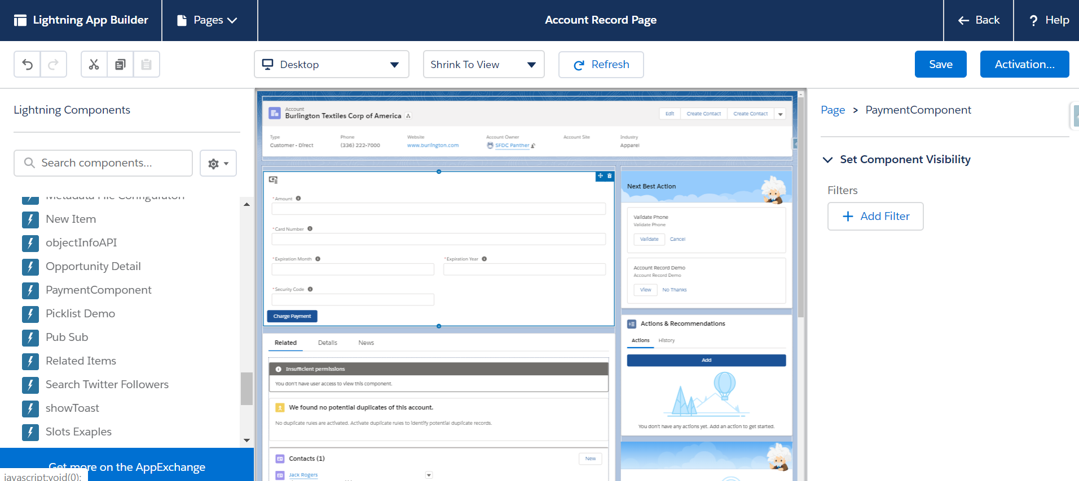
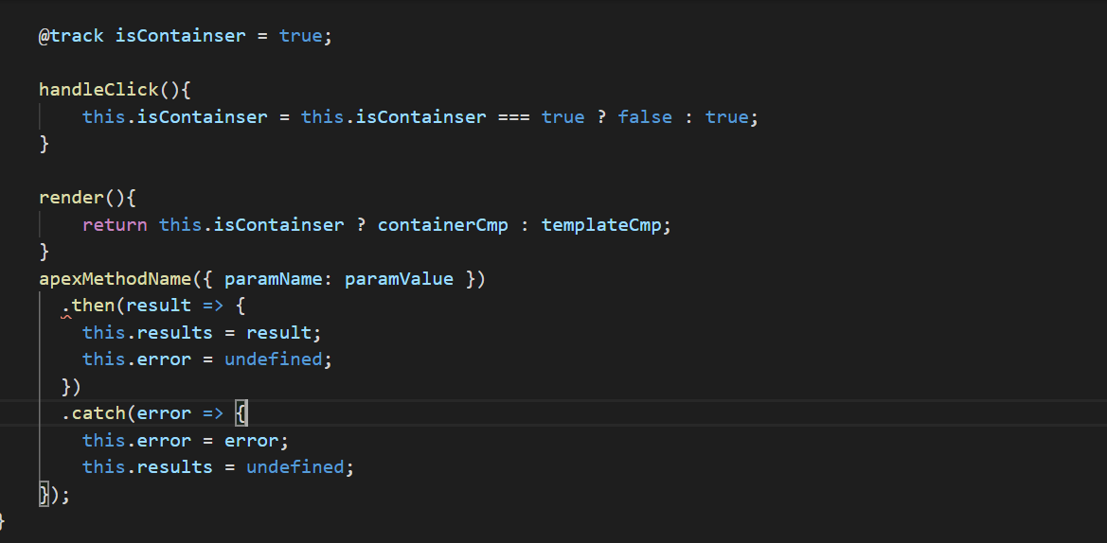
Introduction to LWC
Enhanced Productivity
ES6+, Custom Elements, Modules & Custom Templates
Enhance performance
Easy to Use
Use Modern web standards.

Slide 6
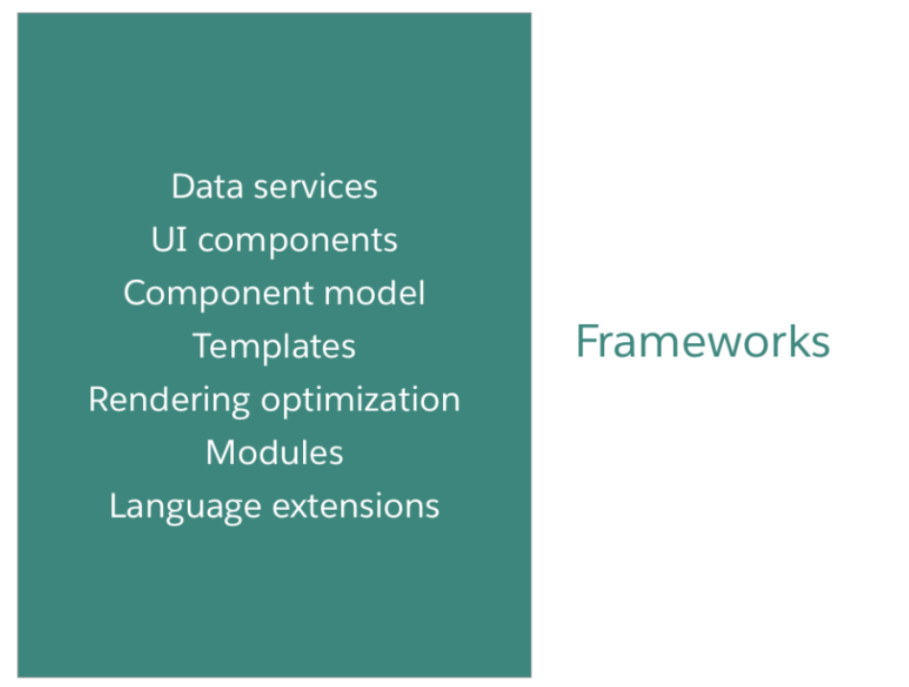
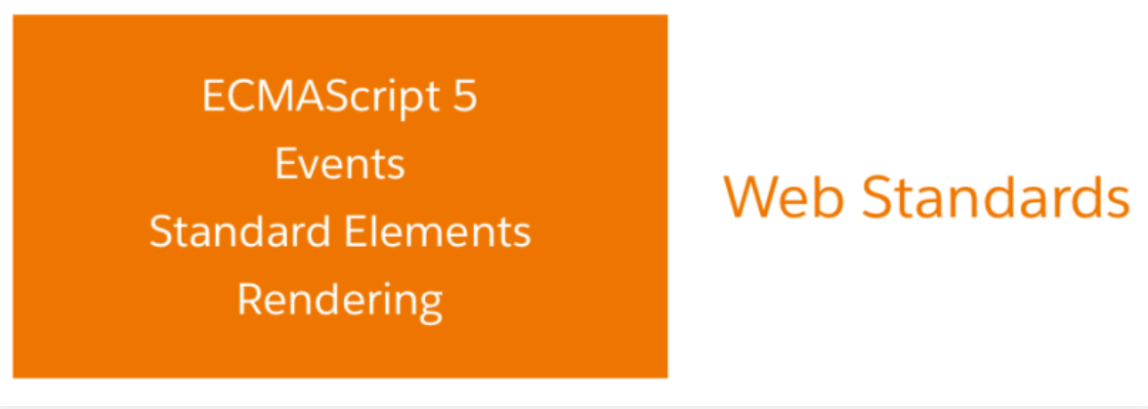
Why LWC
2014 Web Stack
To bridge the GAP
React
Angular
Aura

Slide 7

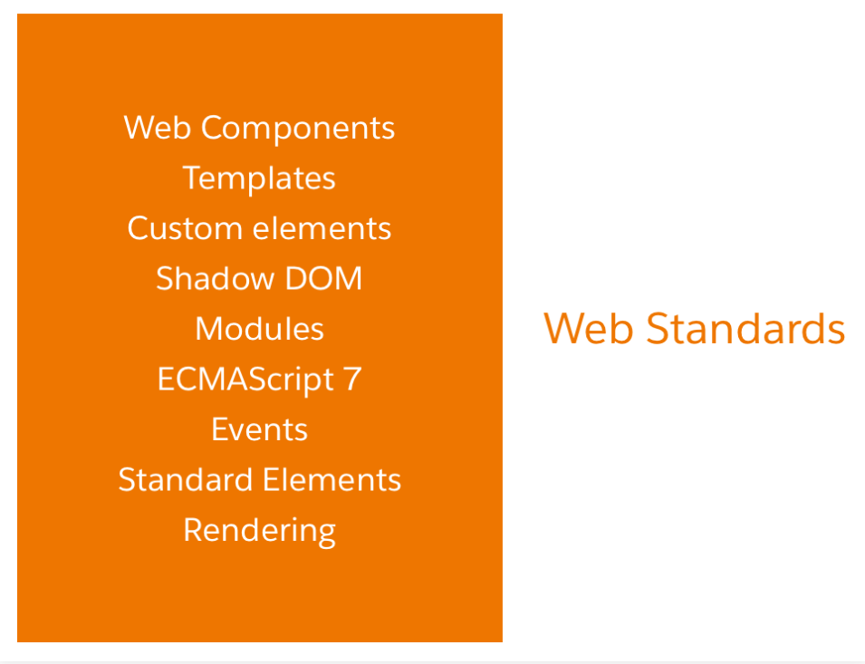
Why LWC
The 2019 Web Stack
Common component model
Common programming model
Easier to find & easier to ramp-up developers
Better performance

Slide 8
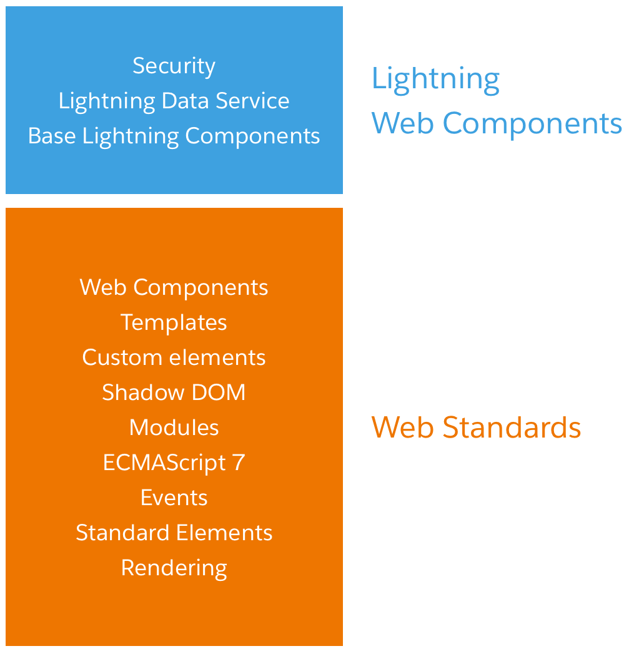
The LWC Stack

Slide 9
The UI Evolution
S-control
VF
Aura
LWC
Till March 2010 ( S – Control )
March 2010 – Current ( VF Page )
2014 – Current ( Aura )
2019 – current ( LWC )

Slide 10
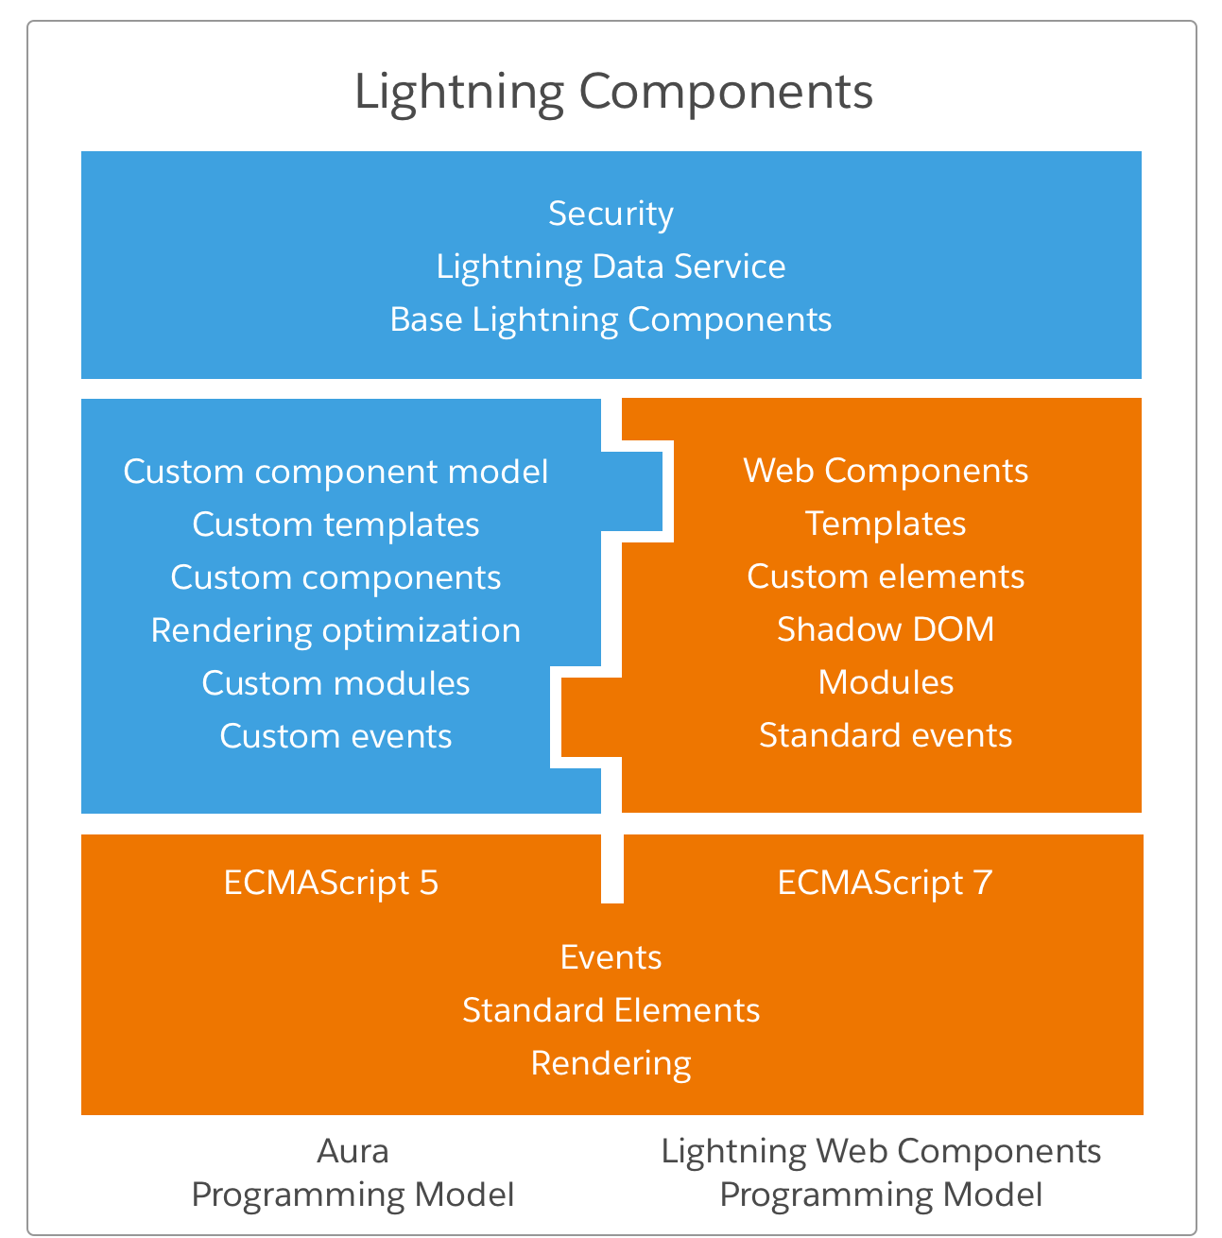
Aura vs LWC

Slide 11
Software Installation
JDK
VS Code
Latest version VS Code
Salesforce Extension pack ( Extension )
CLI
Salesforce Command line interface
latest version JDK
Salesforce lightning code snippets ( Extension )

Slide 12
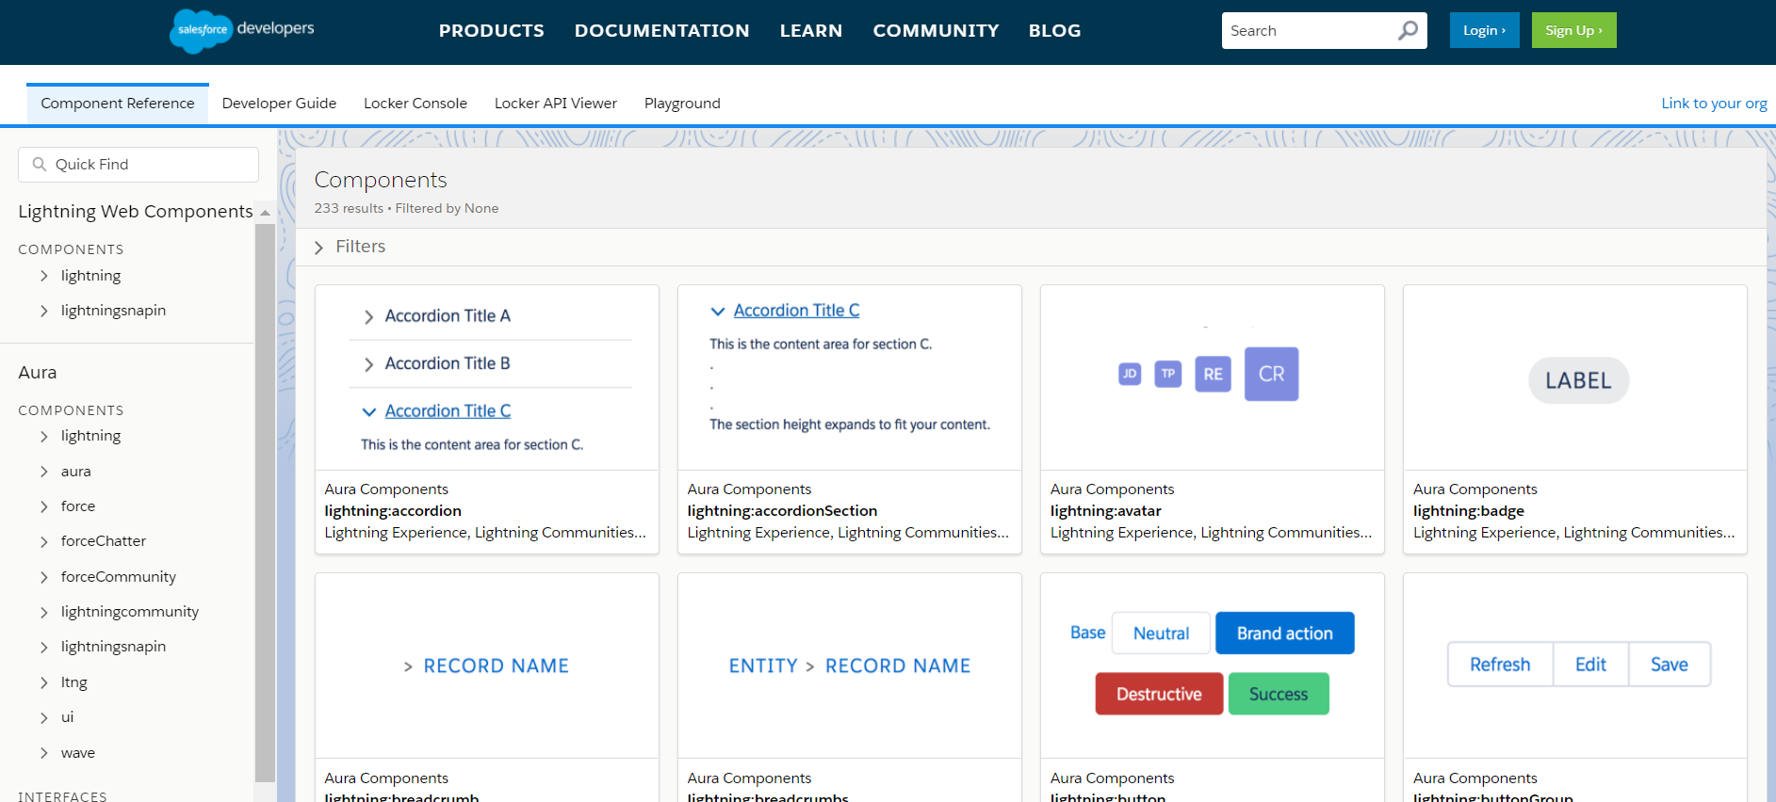
Lightning Component Library

Slide 13

Demo 1
Create your First Project using VS Code

Slide 14
Properties in LWC
Properties in LWC
Public Property
api ( reactive )
Private Property
track(reactive )
var/let/const

Slide 15

Demo 2
Work with properties in LWC

Slide 16

Call Apex From LWC
wire
imperative

Slide 17
What to do next
Introduction to Lightning Web Component Salesforce Document
Introduction to Lightning Web Component ApexHours Video
Build Lightning Web Components Trailhead
Register for the next Session - http://bit.do/ApexHoursDev

Slide 18

Questions? …

Slide 19





Where to go from here
#SalesforceApexHours @ApexHours
www.ApexHours.com
https://trailblazercommunitygroups.com/farmington-mi-developers-group/
https://www.youtube.com/channel/UChTdRj6YfwqhR_WEFepkcJw/videos
https://www.facebook.com/FarmingtonHillsSfdcdug/?ref=bookmarks

